Slide 1

Slide 1
By Melanie Gundy
Vision Zero was first adopted by
New York City in 2014
Sweden first developed this strategy in the 1990’s.
eliminating traffic fatalities
AND severe injuries across Europe WHILE
increasing safe, healthy, equitable mobility
After years of proved successful implementation across Europe
major cities throughout The United States have started utilizing these strategies.
2012
-
2022
NYC Bicycling Incidents
Notes:
.nyc.gov.visionzero
https://seesense.cc/blogs/all-case-studies/vision-zero-and-cycling

Slide 2
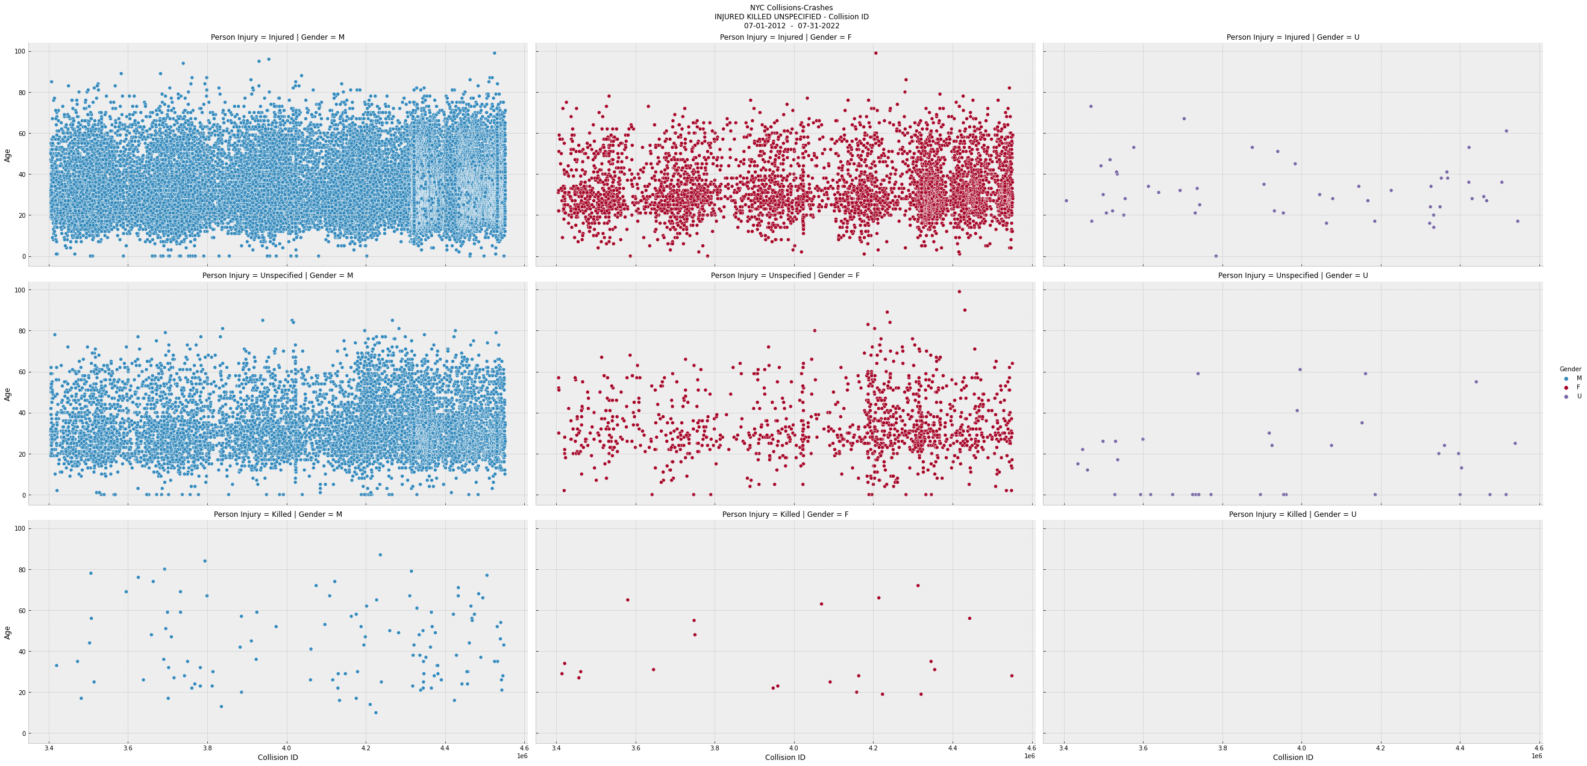
2012-2022s Bicyclists involved in collisions/crashes
Notes:
Unspecified Injured or killed values
Incidents reported by the police involve 1000$+ worth of damage or not being able to leave the scene.

Slide 3
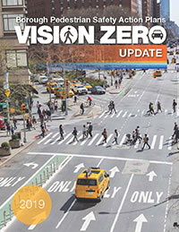
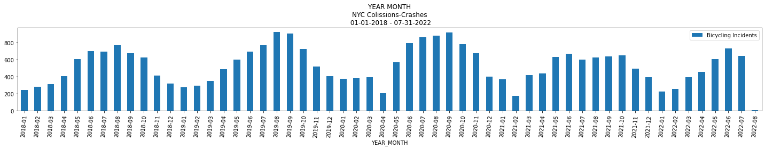
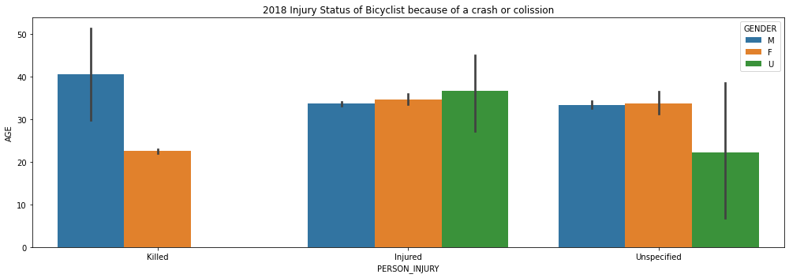

































Slide 7
Traffic fatalities fallen, from 701 in 1990, to 381 in 2000,
to an all-time low of 202 in 2018. Traffic deaths in New York City have fallen by a third since the year before Vision Zero began, bucking the nationwide trend towards increased fatalities.
“But it is still not enough.
We can, and must, do better…”
🚴
citizen action from the grassroots up
2018- Present Bicycling incidents that resulted in NYPD Collision and Crash report being added to the Department of Motor Vehicles database. Injury:
Injured 22916
Killed 101
Unspecified 6664
Injured:
Male 25630
Female 4001
Unspecified 50
Notes:
These incidents are classified by date and time resulting in a Unique and Collision ID being Assigned by the NYPD.

Slide 4
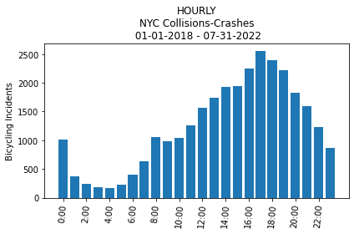
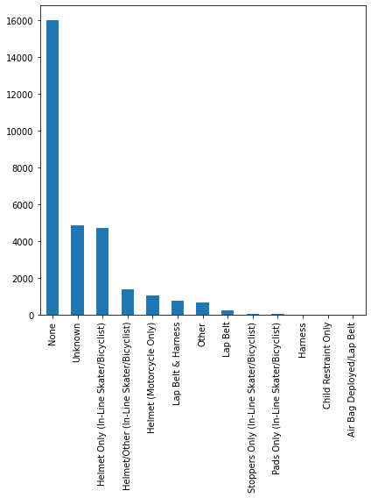
Slide 2
Hourly Incidents
Bicyclists involved in Collisions and Crashes
Most accidents involving bicyclists are during
4:00 – 7:00
The greatest amount of persons involved are not utilizing safety equipment

Slide 5
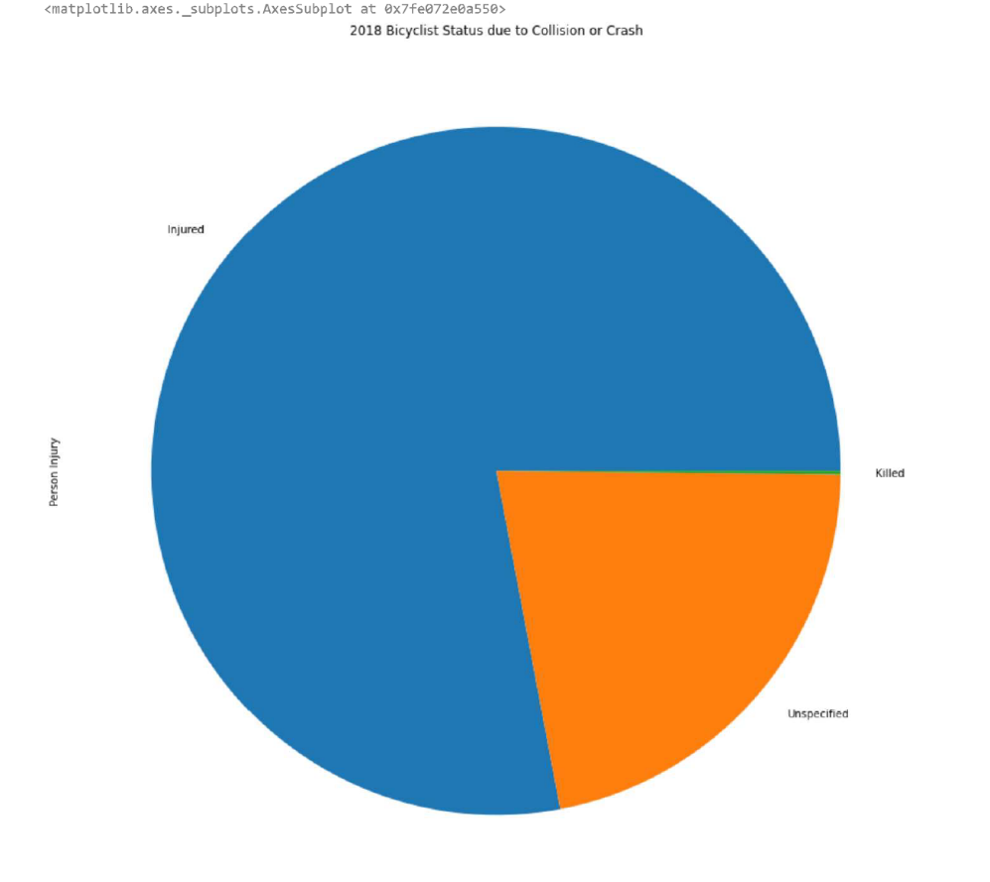
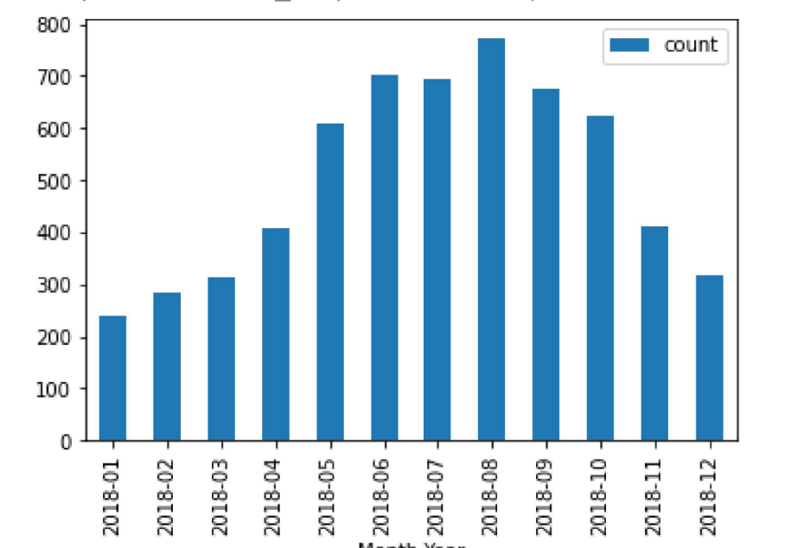

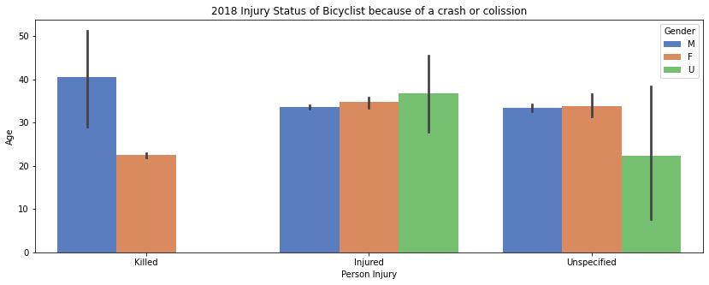
Slide 4
2018 Person Injury
Most accidents involving bicyclists are during the month of August. Ridership and accidents are mostlikely a bifactor of increased activity during the summer months.

Slide 6
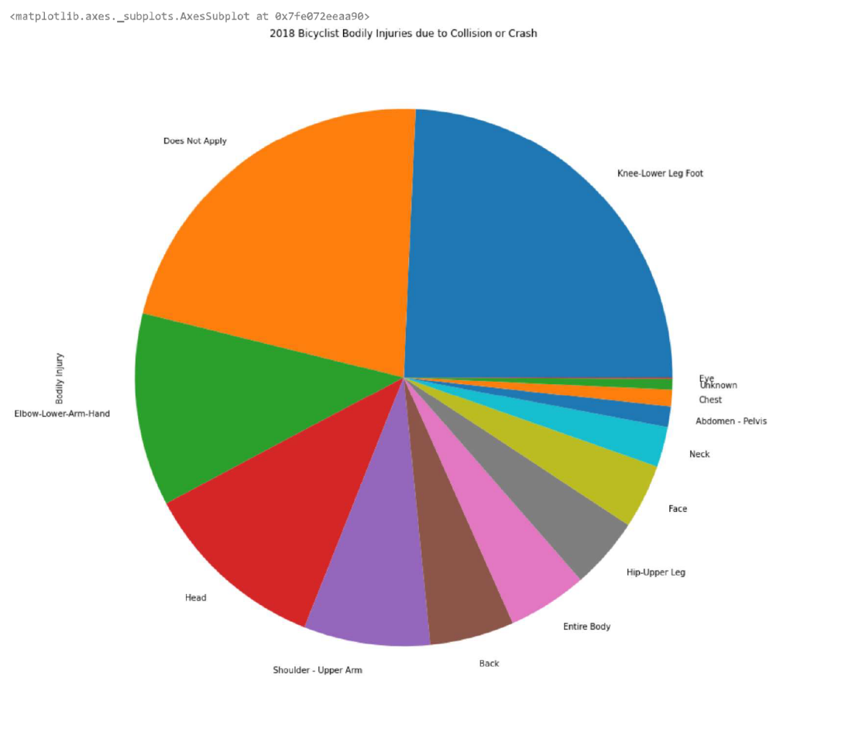
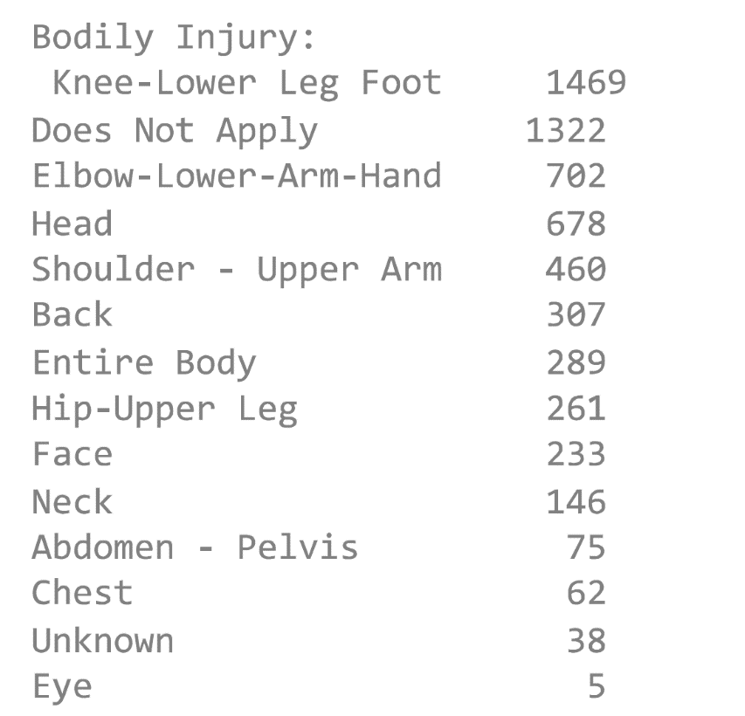
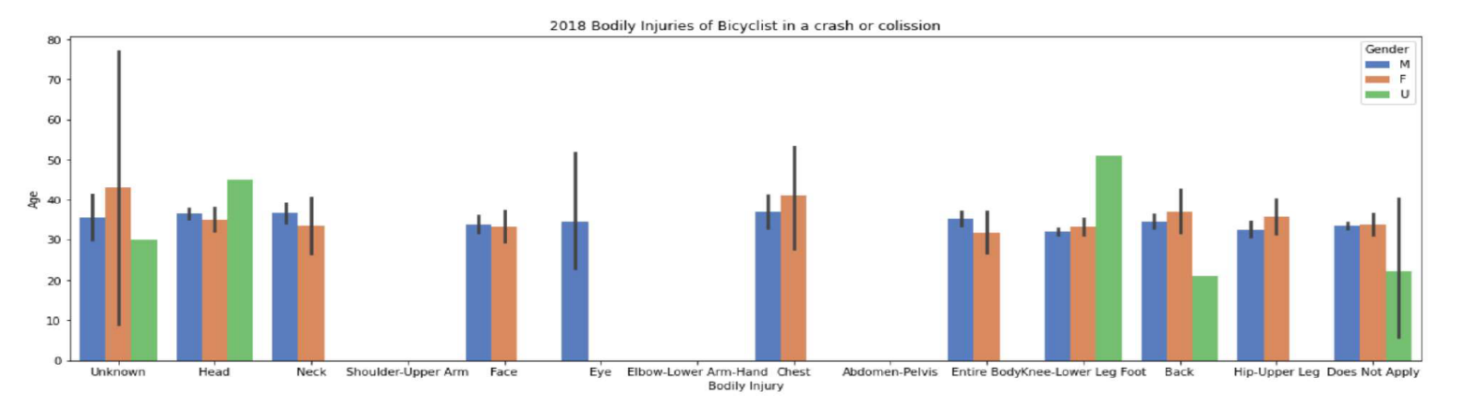
Slide 5
2018 Bodily Injuries

Slide 7
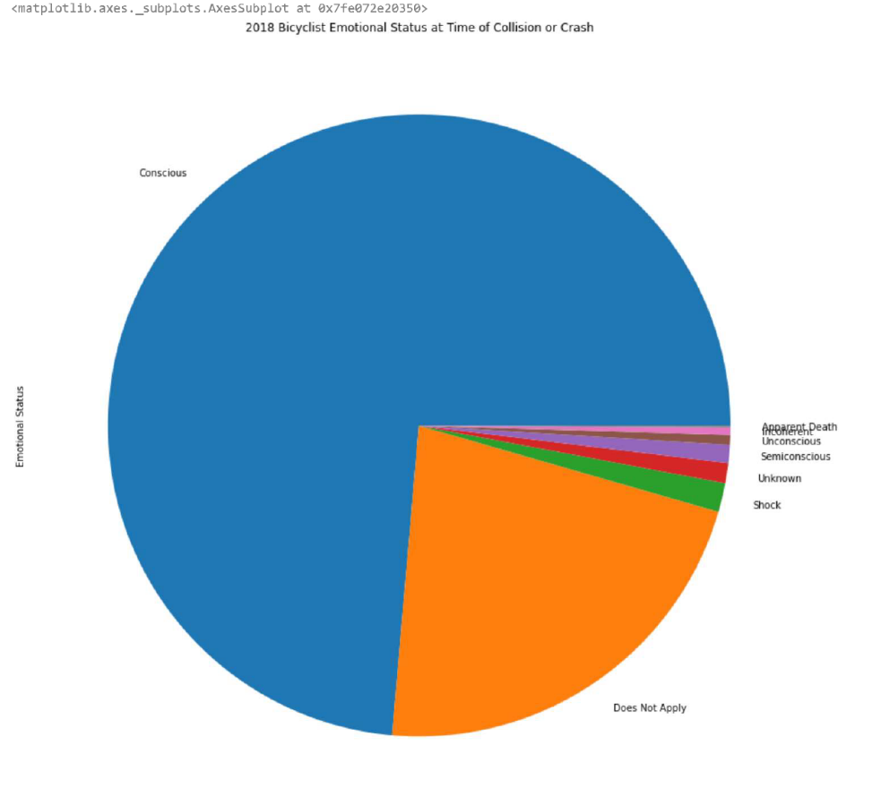

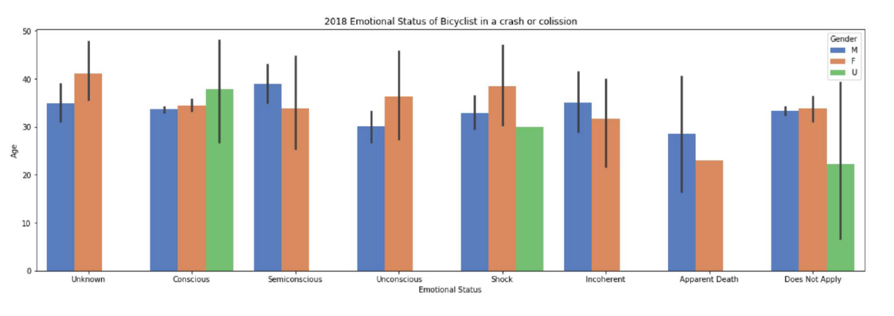
Slide 6
Emotional Status

Slide 8
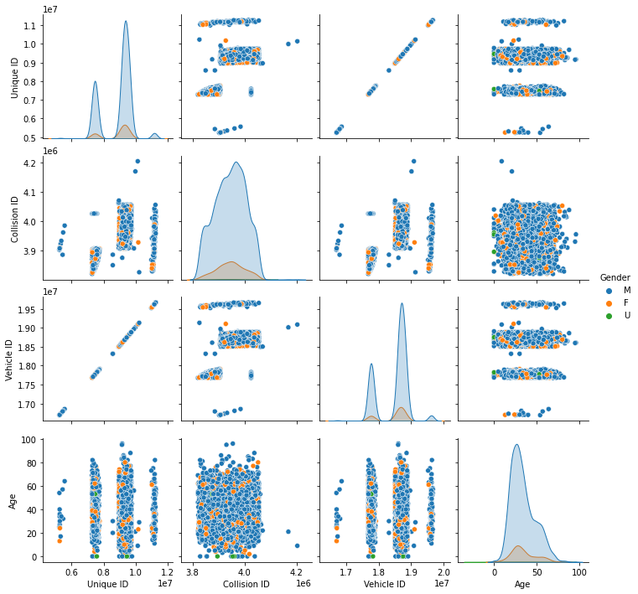

Slide 8
2018 Bicyclists
Involved in collision and crashes classified by gender

Slide 9

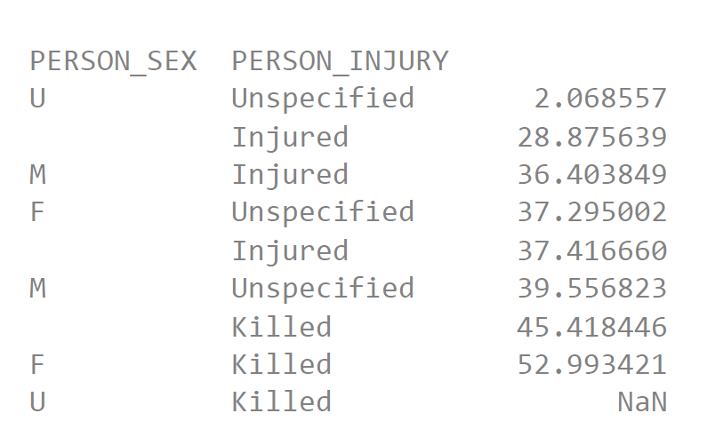

Slide 3
2014 to present
“Today in New York, approximately 3,000 New Yorkers are seriously injured and more than 200 are killed each year in traffic crashes. Being struck by a vehicle is the leading cause of injury-related death for children under 14, and the second leading cause for seniors.
Traffic fatalities in New York have indeed fallen significantly, from 701 in 1990, to 381 in 2000, to an all-time low of 202 in 2018.” – vision zero

Slide 10
https://data.cityofnewyork.us/Public-Safety/Motor-Vehicle-Collisions-Person/h9gi-nx95 Updated April 19, 2021 Data Provided by: Police Department (NYPD) Initial import file: Rows: 4,757,334 Columns: 21 Future additions will include the same information and charting of the years 2019-Present Further exploring the safety equipment that was reported as used are more women or men utilizing saftly equipment? Locating geodata related to each bicyclist incident time/and relating it to the expansion of CitiBike rideshare and the Vision Zero green zones -safety equipment? Revel provides a helmet does/could citibike also at some locations?

Slide 11
